Slide 1

Encryption and Decryption in C
By Brett, Ernest, and Zachary

Slide 2

Why do we encrypt information?

Slide 3
How do we hide something
Encryption uses algorithms and ciphers to protect information.
Common Encryption Methods:
  Rotation (Caesar Cipher): Shifts letters by a set number.
Substitution: Replaces letters with other letters or symbols.
  Mathematical Algorithms: Use mathematical operations and keys to encrypt data.
Multiple Methods: Modern encryption often combines several mathematical operations.
How Does It Work?
  Plaintext: The original message.
  Encryption: Apply a cipher and key.
  Ciphertext: The encrypted message.

Slide 4

Our code

Slide 5





Rotation Cypher!
This code allows us to add special characters to our rotation so things like "!" and "," are rotated too
This allows you to put in negative rotation values and have them translated to positive ones so –1 = 25
This code goes through the text until it finds a null character to know where the text string ends

Slide 6

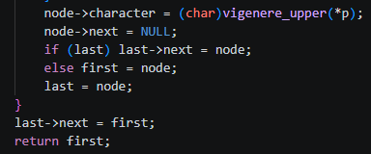


Vigenère Cypher!
This uses a linked list so every letter in the key points to the next one
This converts any lowercase letters to uppercase and makes the end letter wrap around to the front
Circular Linked List!
This shifts each letter forward (or backward) using the current key letter, then advances to the next node in the circle.

Slide 7

Demonstration
Hope this will be fun at the expense of Brett
Rotational Cypher

Slide 8
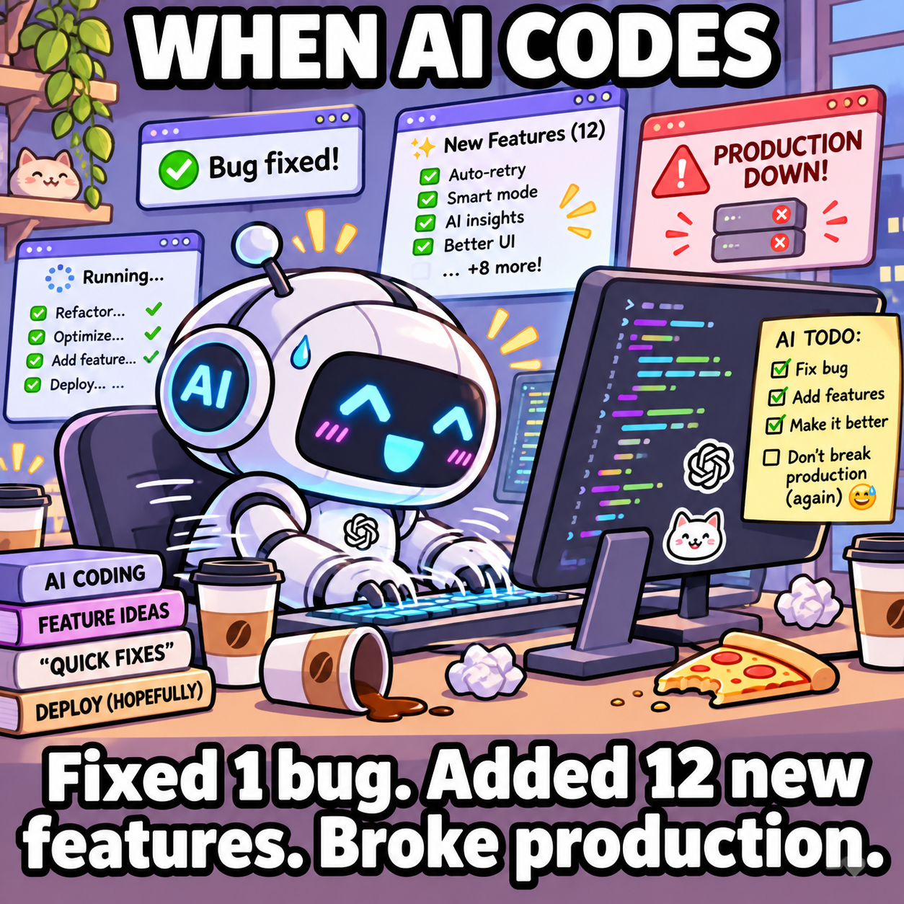
Q&A
(Made by AI)

Slide 9
Sources
ChatGPT + Claude
  Code integration
  Error Handling
  Meme generation

